Slide 1

Toolkit Doc5 CB
April 26, 2010

Slide 2
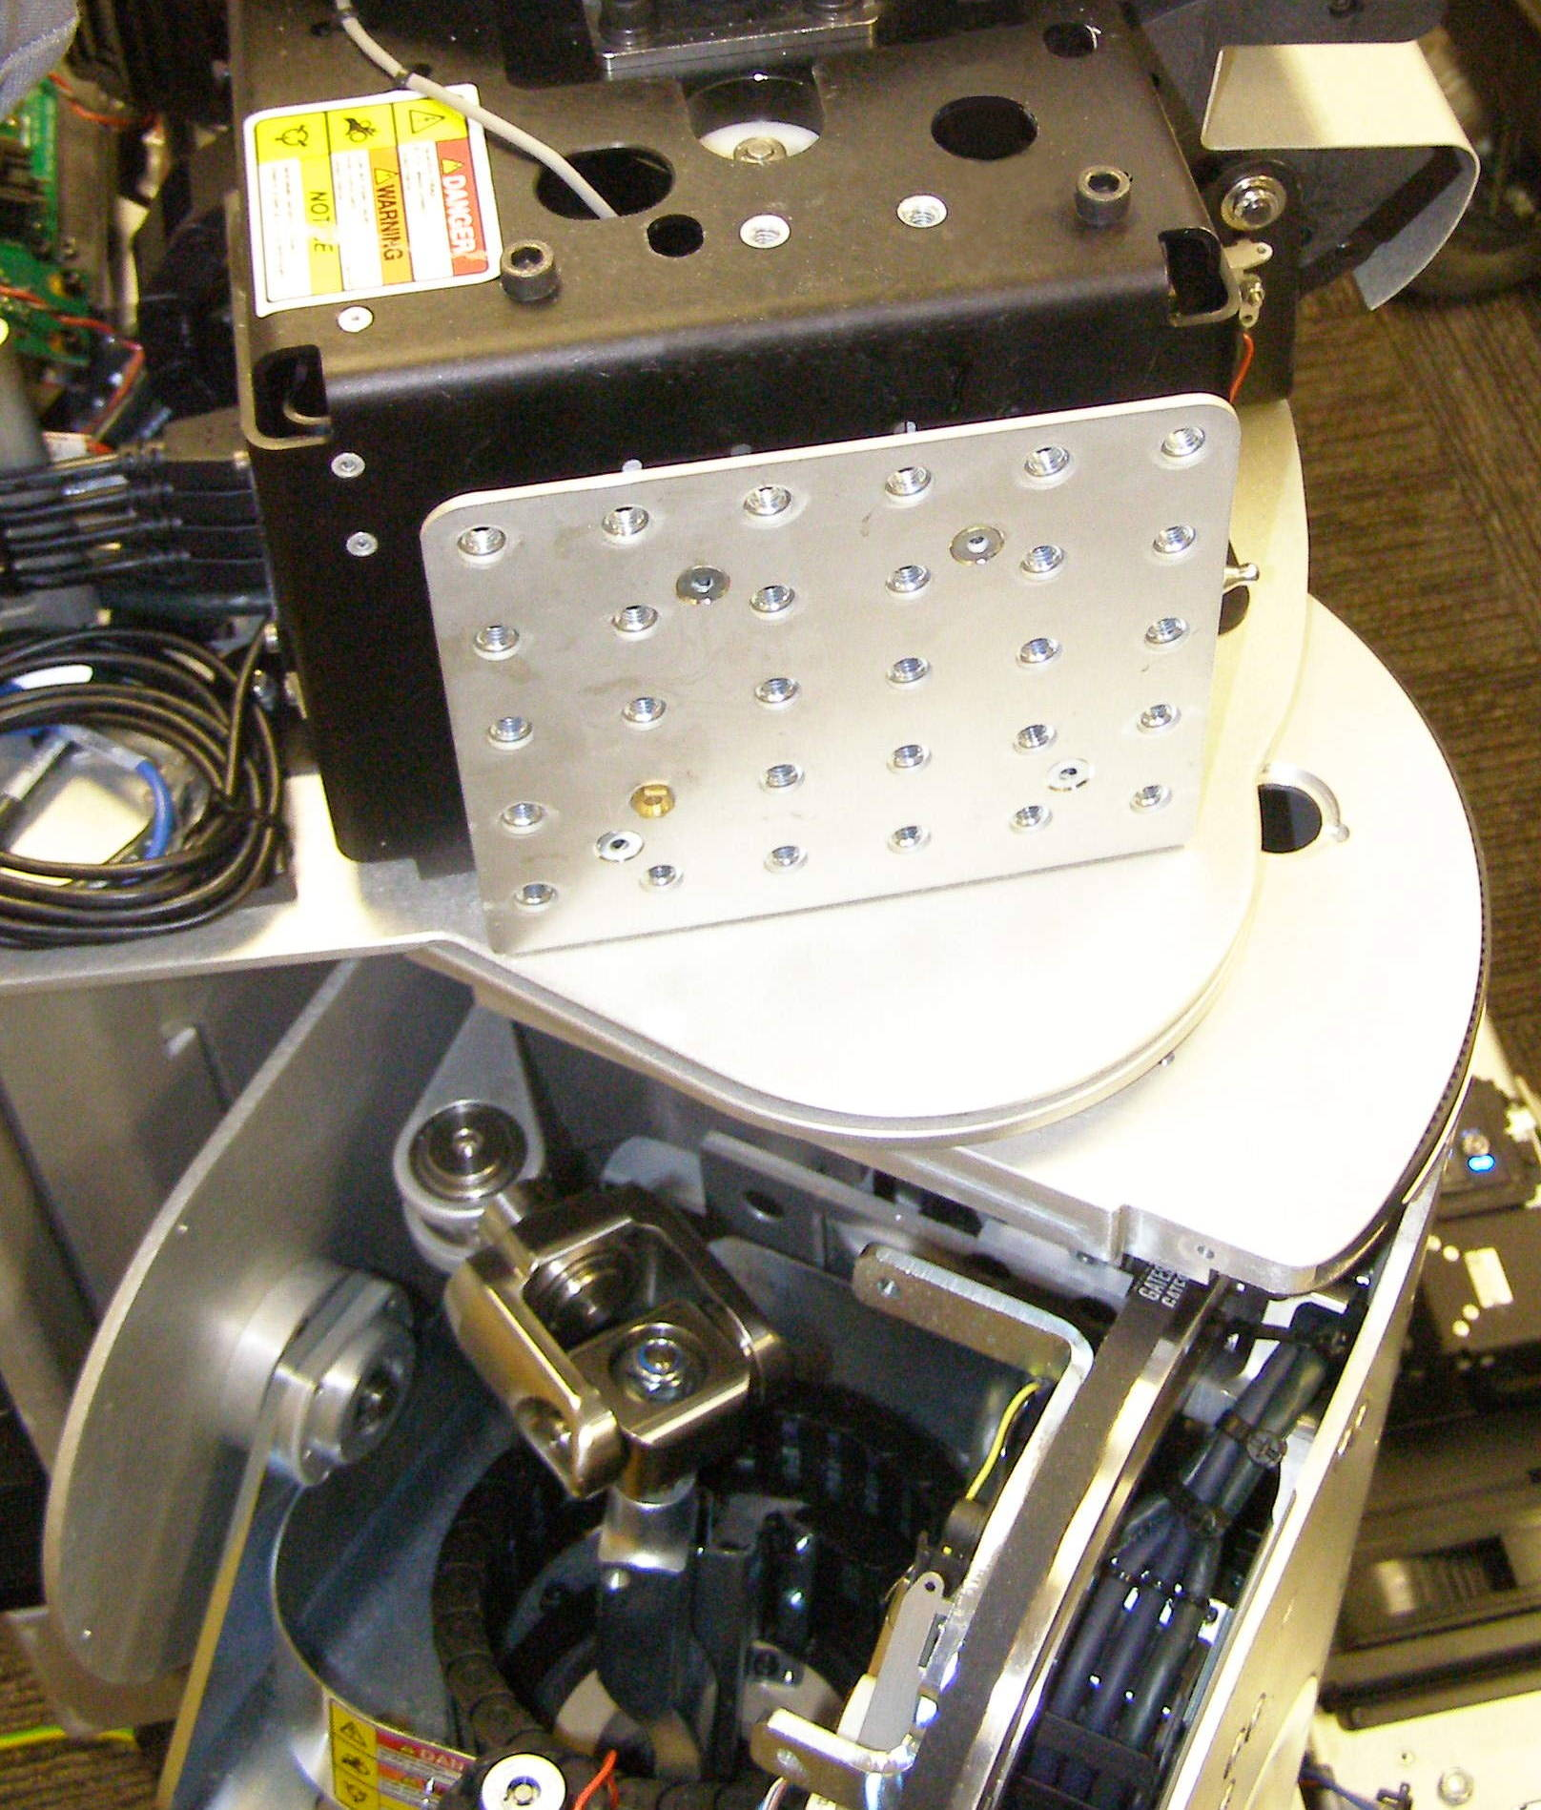
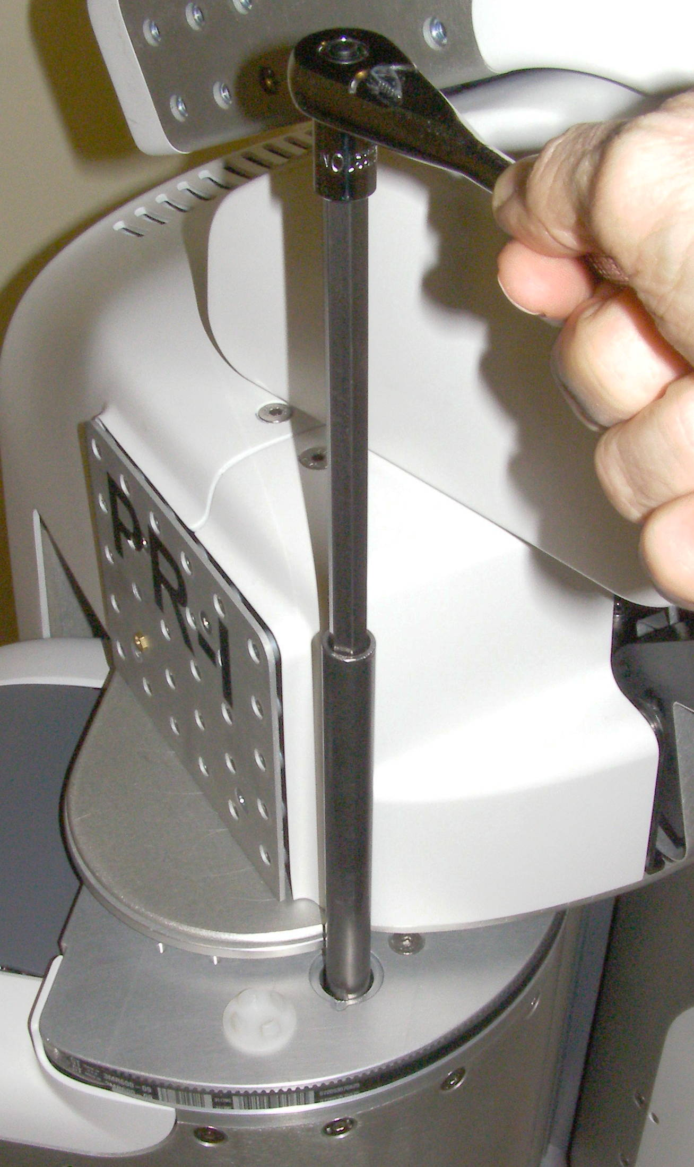
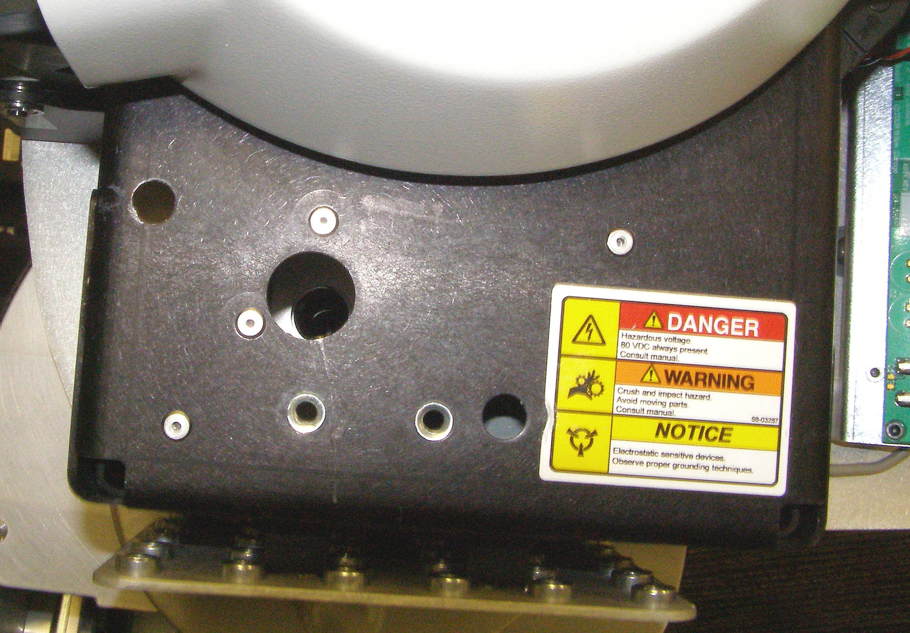
Counter Balance Adjustment (1)
The object of the Counter Balance (CB) adjustment is to compensate for the weight of the arm assembly so that the extended arm stays approximately horizontal without any motor actuation. The Fore Arm should also be neutral in all positions. Normally we will not have to adjust the Primary spring tension unless the Upper Arm has just been installed. The Arm Gimbal Shaft adjustment is designed to affect the overall Arm balance while the Secondary spring adjustment is intended to normalize the Fore Arm balance, but it will affect the overall Arm balance as well. Turning the Secondary spring adjustment clockwise increases the Fore Arm lift in relation to the Arm, while lifting the Arm as well. Turning the Arm Gimbal Shaft counter-clockwise will raise the Arm.
Remove Shoulder Covers
Remove Front and Rear Top Covers
If the Upper Arm has been replaced, execute the following steps:
  Rotate the Arm so as to expose the Primary spring adjustment access hole cap and if it is not already removed, remove it with a small flathead screwdriver (not supplied). Insert the steel guide tube through the Primary access hole. Using the 10mm rod together with the 10mm 1/4 drive socket and the 1/4 drive ratchet wrench, turn the Primary adjustment clockwise until it is fully seated and will not turn further. Back off the adjustment half a turn to break the lock. (Fig 2)
  Rotate the Arm so as to align the Secondary adjustment access hole. The position required will be different from the left side to right side (Fig 3)
Fig 1
Right
Secondary
Tube
cap
Primary
Primary
Arm Gimbal Shaft
Fig 2
Fig 3
Left
Secondary

Slide 3
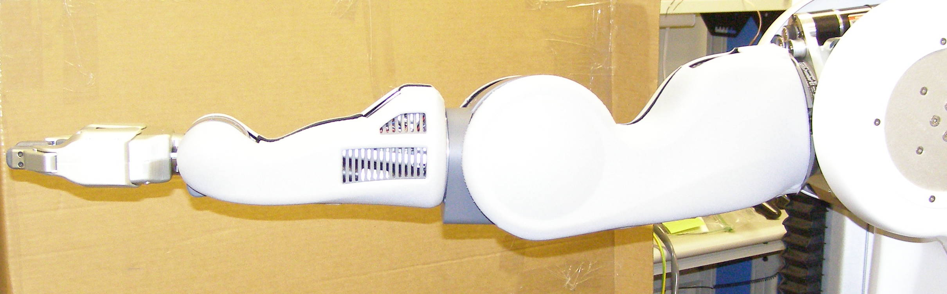
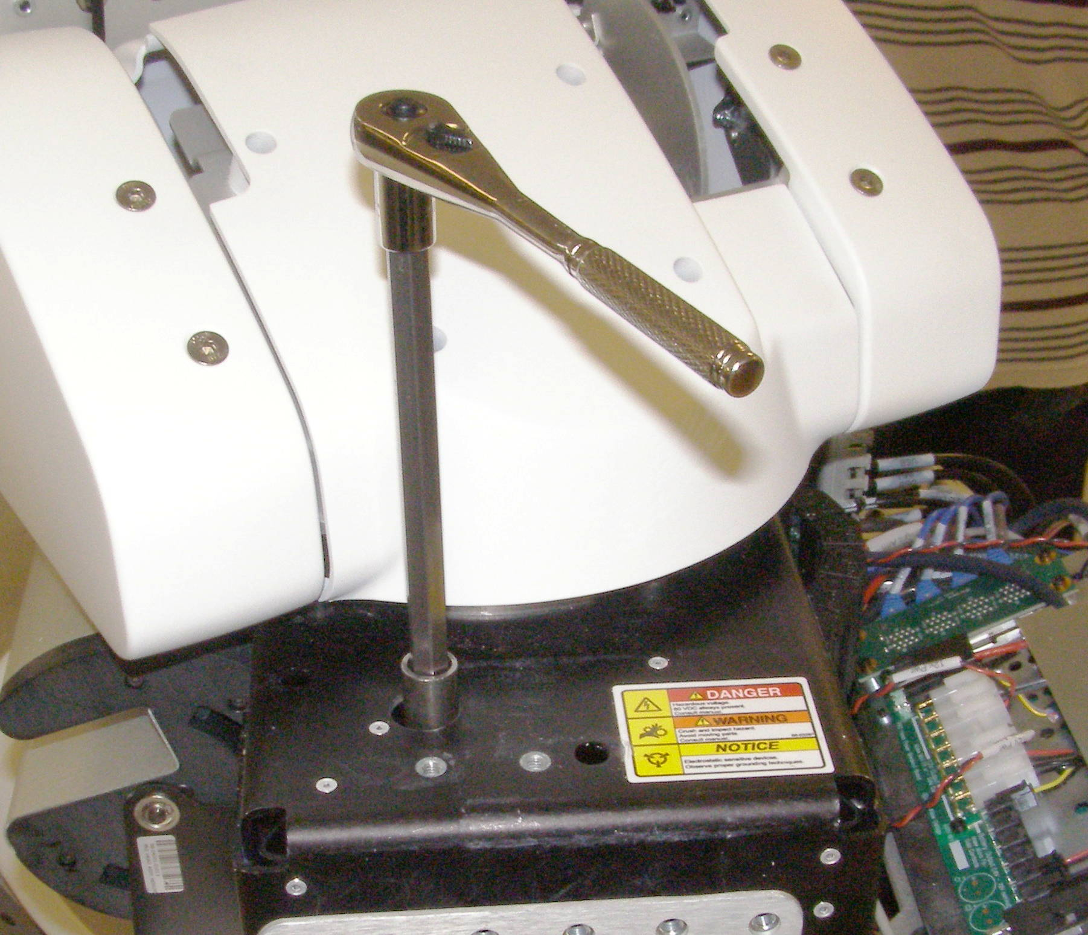
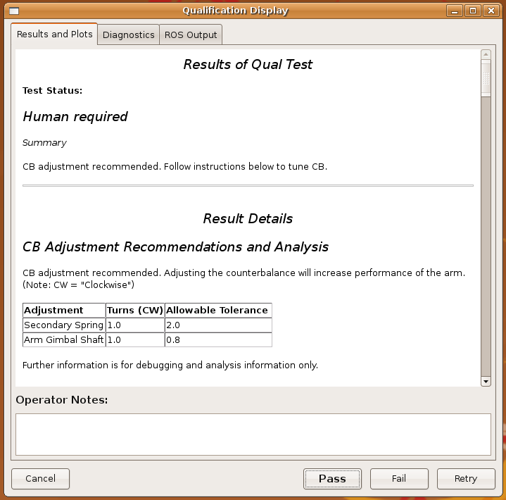
Counter Balance Adjustment (2)
  Turn the Secondary adjustment clockwise until the fully extended Arm will hold position. It can drift up or down some. (Fig 4)
  Note: It is assumed that the Arm Gimbal Shaft has already been adjusted in accordance with the Upper Arm Installation procedure.
Run the CB Check program. Make sure there is adequate clearance around the robot for the Arms to move freely. The results should look something like this:
To adjust the Secondary spring:
  First install the steel guide tube through the Secondary access hole making sure that it is bottomed out and protrudes about 1.5cm. (Fig 5)
  Use the 10mm rod together with the 10mm 1/4 drive socket and the 1/4 drive ratchet wrench to adjust the Secondary spring tension.
  If the check result is a positive number, rotate the Secondary adjustment clockwise, which will tend to raise the Fore Arm.
  If the check result is a negative number, rotate the Secondary adjustment counter-clockwise, which will tend lower the Fore Arm.
Fig 4
Fig 5
tube

Slide 4
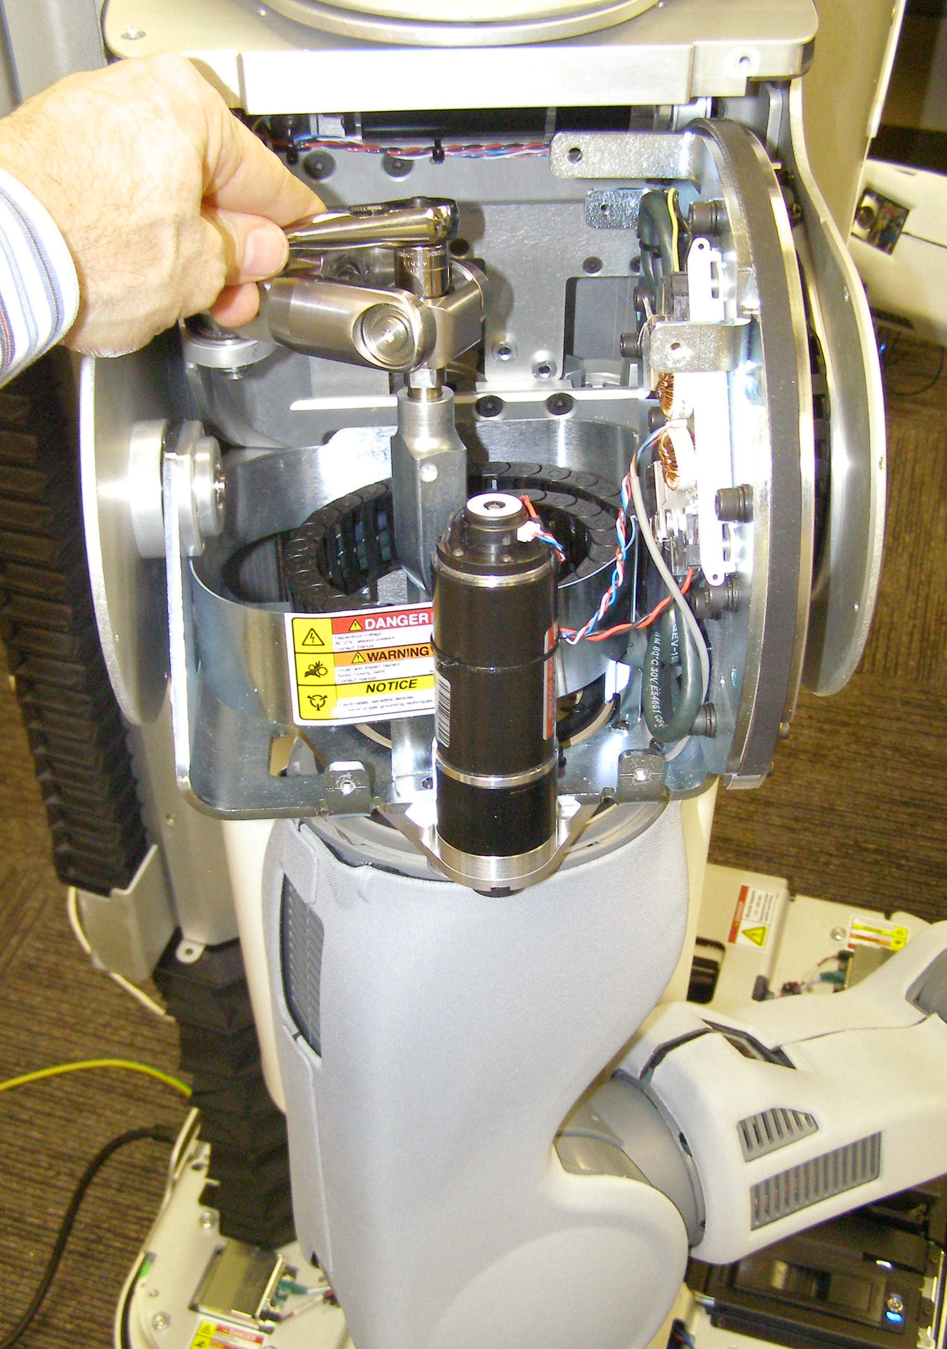
Counter Balance Adjustment (3)
To adjust the Arm Gimbal Shaft:
  The Arm should be lowered and rotated to the right to facilitate access to the Arm Gimbal Shaft nut. Use the ¼ drive ratchet wrench with the ¼ drive 13mm socket. (Fig 6)
  If the check result is a positive number, rotate the Arm Gimbal Shaft counter-clockwise, which will raise the Arm.
  If the check result is a negative number, rotate the Arm Gimbal Shaft clockwise, which will lower the Arm.
The Arm Balance Check proceedure should be run again to verify that the Arm is within its balance tollerance. The check / adjustment cycle may need to be done a couple of times to reach acceptible tollerqnce levels.
Fig 6

